Slide 1

Texas Christian University
Physician Associate Studies

Slide 2
Mission Statement
Our mission is to develop extraordinarily competent and compassionate Physician Associates to provide high quality, patient centered, evidenced based healthcare as a member of a physician-led healthcare team who can think and act responsibly in a global community.

Slide 3
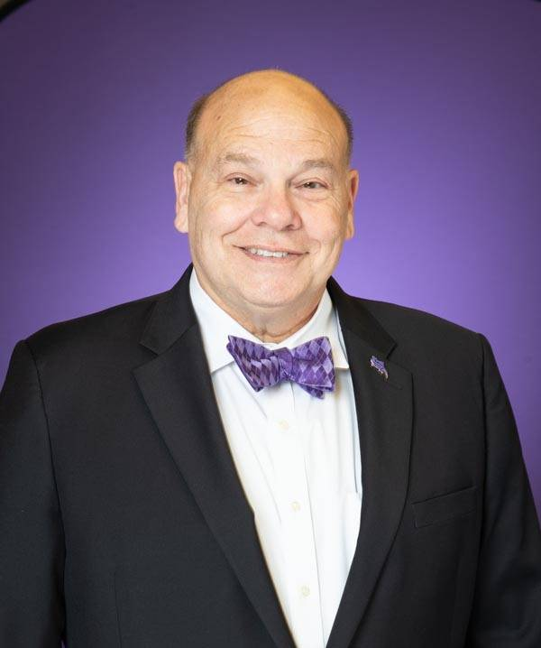
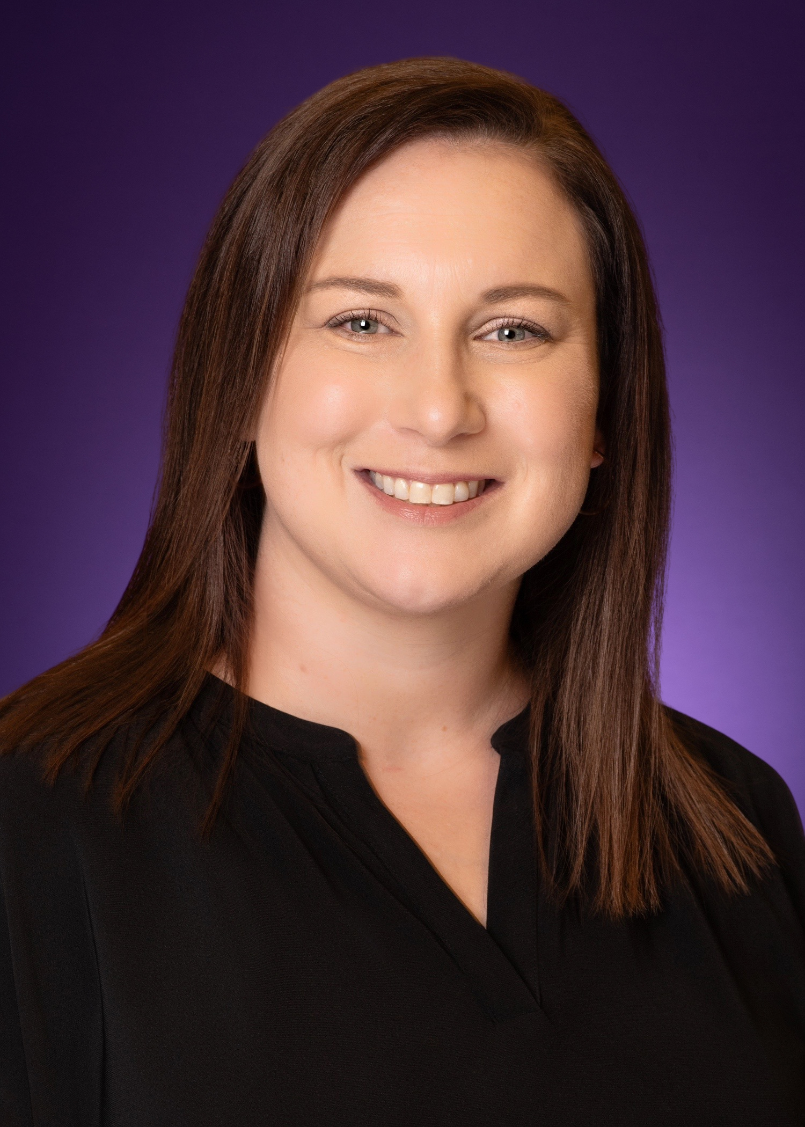
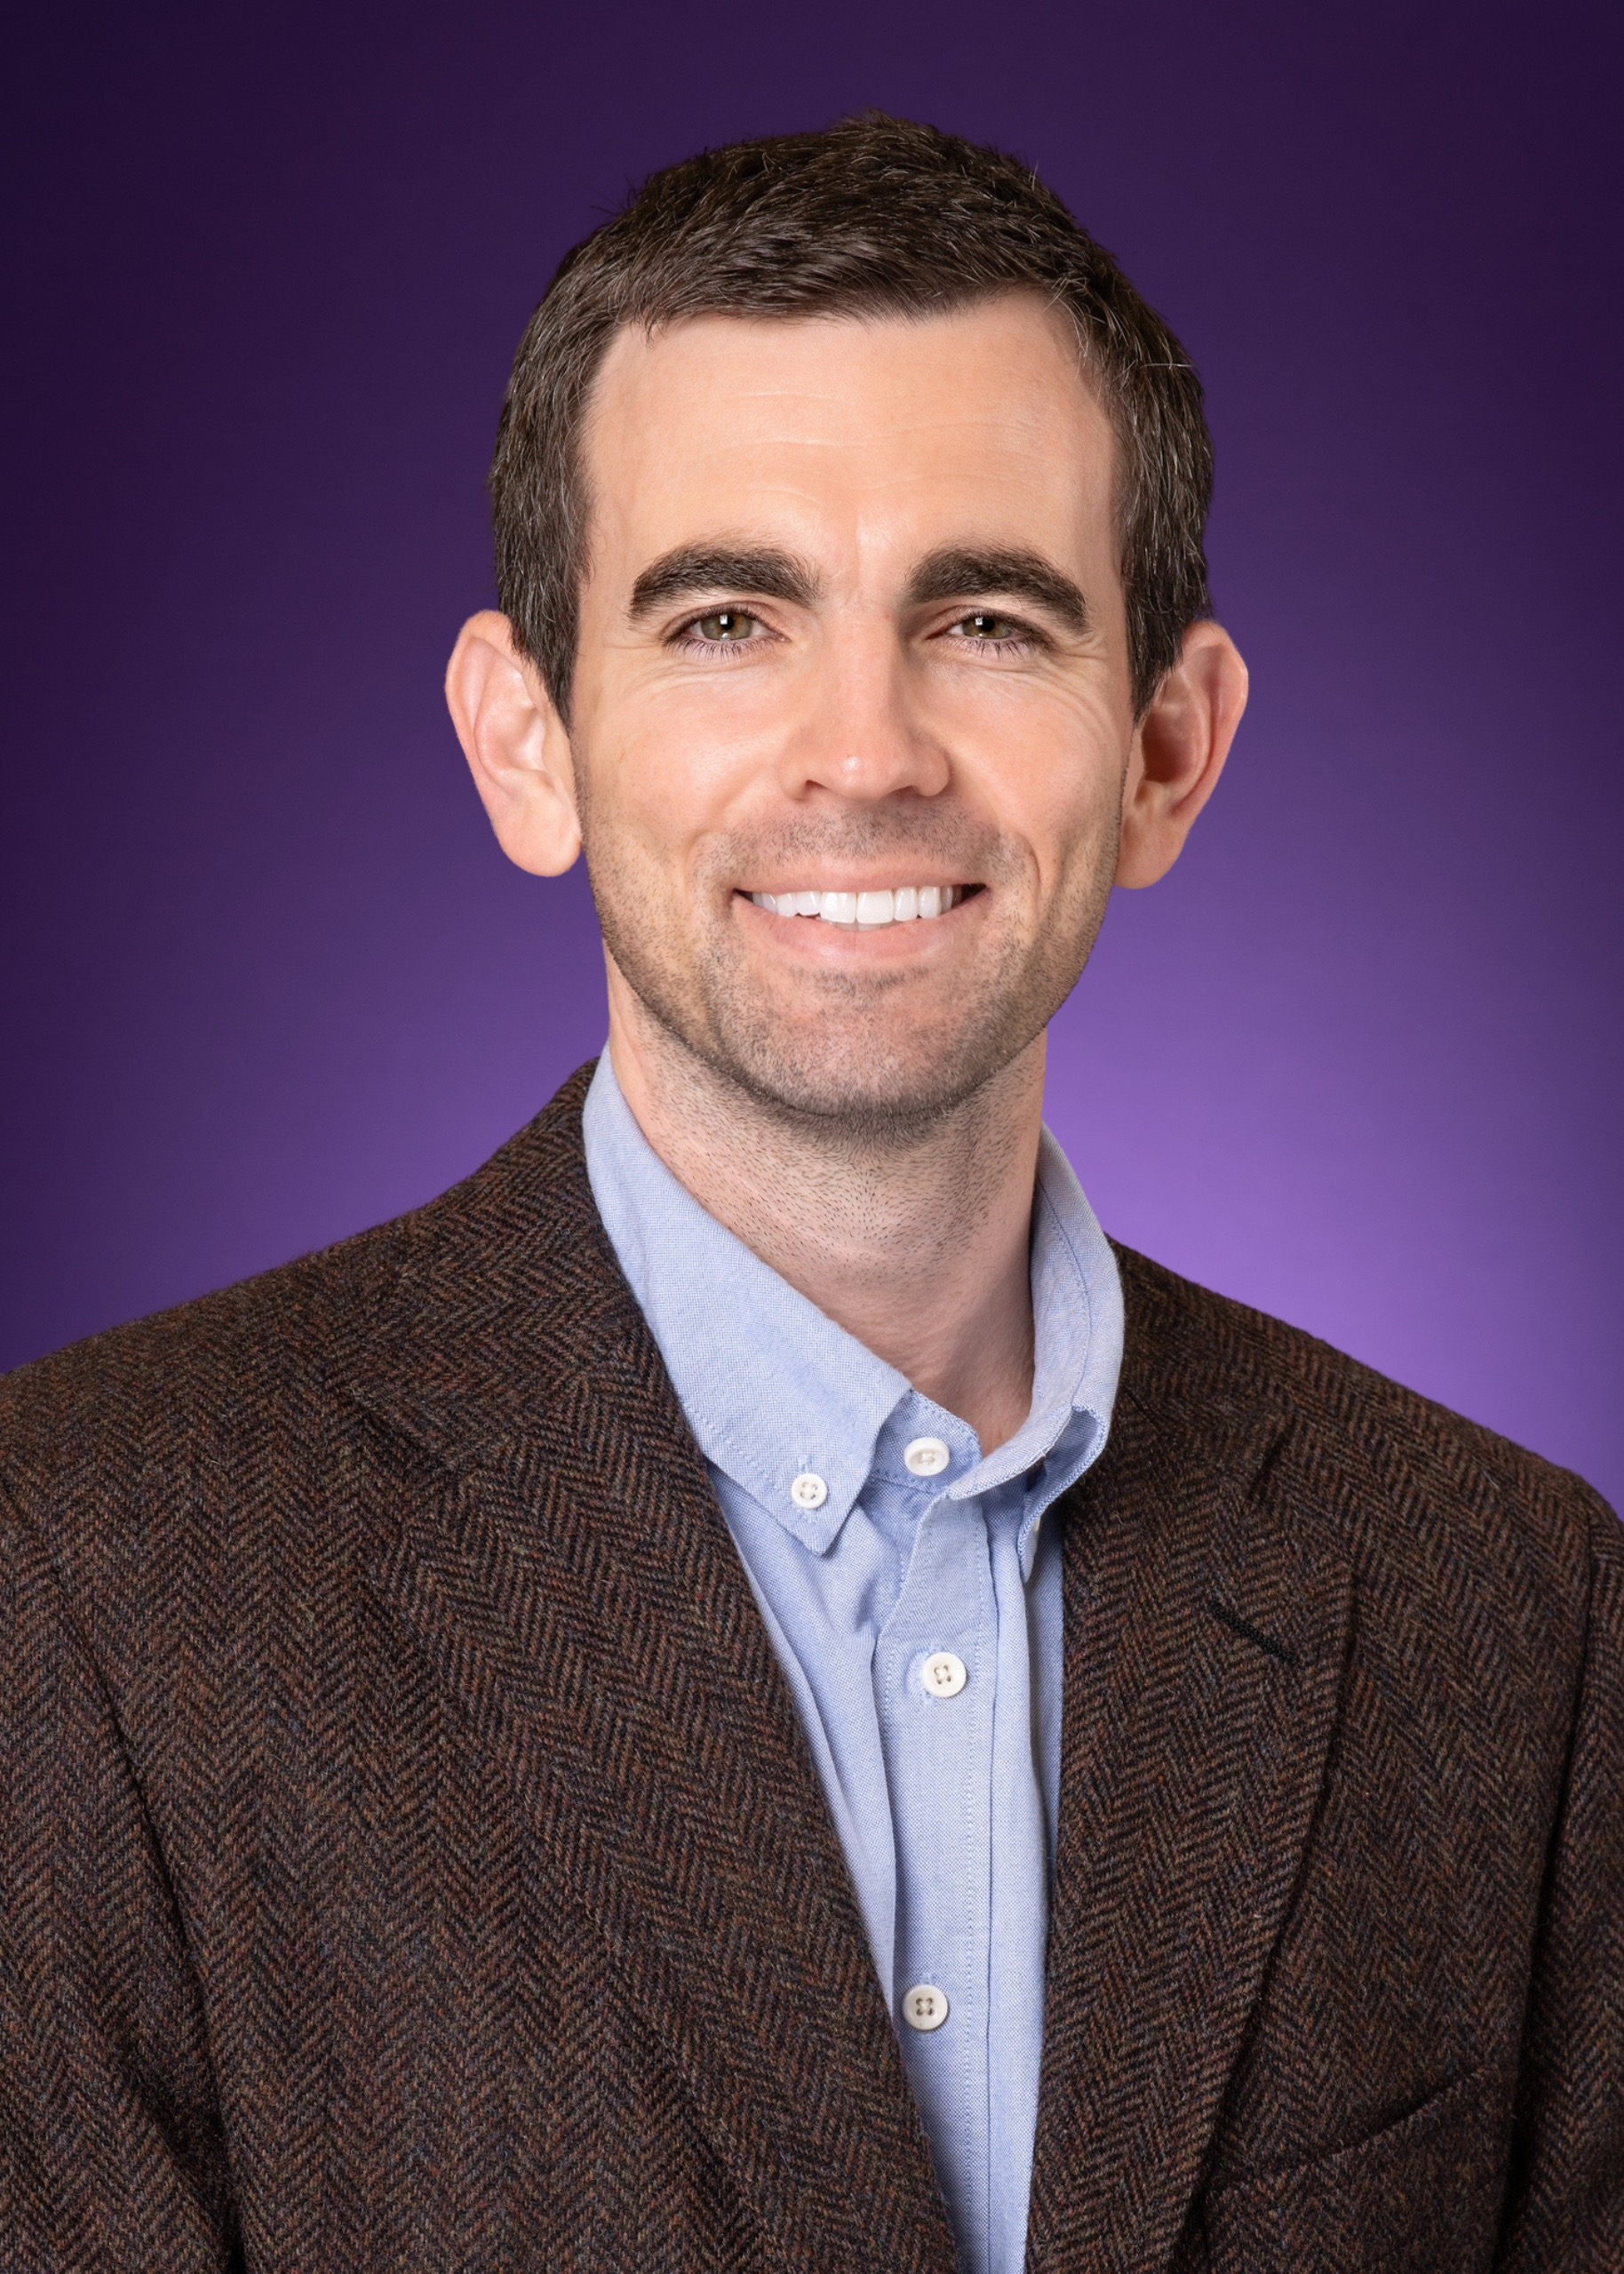


Faculty and Staff
Gary Pérez
Program Director
Carla Hirsch
Director of Pre-Clinical Education
J.P. Hennessy
Director of Clinical Education
Emily Todd
Medical Director
Lisa Smant
Academic Program Specialist

Slide 4
Commitment to Excellence
Experienced Faculty; Over 75% hold doctoral degrees
Curriculum designed to optimize learning and well being
Active experiential learning: reinforces knowledge and sharpens diagnostic skills

Slide 5
Home of TCU PA Studies
Located in the Medical District
1.5 Million Dollar Renovation
Blocks away from TCU Medical School

Slide 6
Accreditation Process
February 2026: ARC-PA Submitted
May 2026: ARC-PA Site visit
October 2026: ARC-PA Commissioners Meet
January 2027: First Cohort Begins

Slide 7
Accreditation Process
May 2026: ARC-PA Site Visit
May 2026-January 2027: Monitoring Provisional Visit
18-24 Months Later: Final Provisional Visit

Slide 8
Curriculum Highlights
1. Foundational Medicine Courses
2. Medical Knowledge & Clinical Skills
3. Clinical Rotations
4. Post Clinical Rotations

Slide 9

Pre-Clinical Phase
14 Months
Systems-Based Curriculum
Lectures + Active Learning
TCU PA Studies Curriculum

Slide 10
System-Based Curriculum
Clinical courses are based on body systems & topics
Topics included in clinical courses:
Physiology and pathophysiology
Acute and chronic medical conditions
Patient evaluation
Diagnostic interpretation
Pharmacology
Patient education
Benefits
Streamlines knowledge acquisition
Strengthens clinical reasoning
Mirrors how a PA approaches patient care

Slide 11
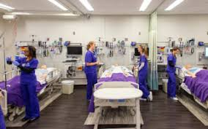
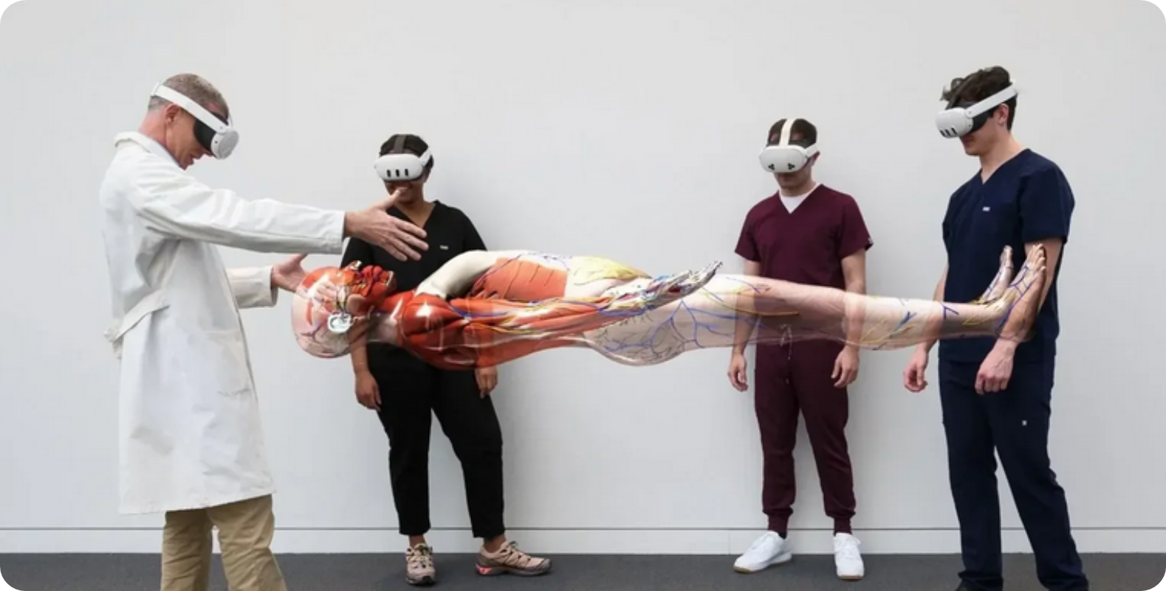
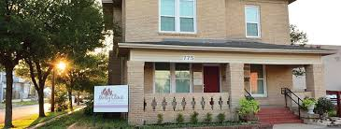
Experiential Learning

Slide 12
Student Centered Design
New material is introduced no later than five days before summative exams
1:10 Faculty/Student Ratio
In person Physician Assistant National Certifying Examination (PANCE) board review before graduation
Access to question banks and software for reinforcing learning of material

Slide 13
Student Support
Mentor, Engagement, & Development (MED) Group
Harris College Academic Resource Center (HARC)
Dedicated Graduate Studies Library and Resources
School of Medicine Databases and Journals

Slide 14
Clinical Phase
7 Core Rotations (4 weeks)
2 Elective Rotations (2 weeks)
Internal Medicine
Pediatric Medicine
Surgery
Emergency Medicine
Women’s Health
Family Medicine
Behavioral Health

Slide 15
Admissions: What are we looking for?
Academic Readiness
Values Alignment
Authenticity
Culture Fit

Slide 16

Prerequisite Highlights
Science prerequisites must be completed within 7 years of admission
All prerequisite coursework must be completed by September 1 in the year before matriculation
AP credit accepted only for Math and English
Physics is required
No minimum number of completed prerequisites is required to submit an application, though competitive applicants usually have the majority completed
Prerequisite Checklist

Slide 17
Timeline & Expectations
Rolling Admissions
Non-Standard offers
Still in Consideration

Slide 18
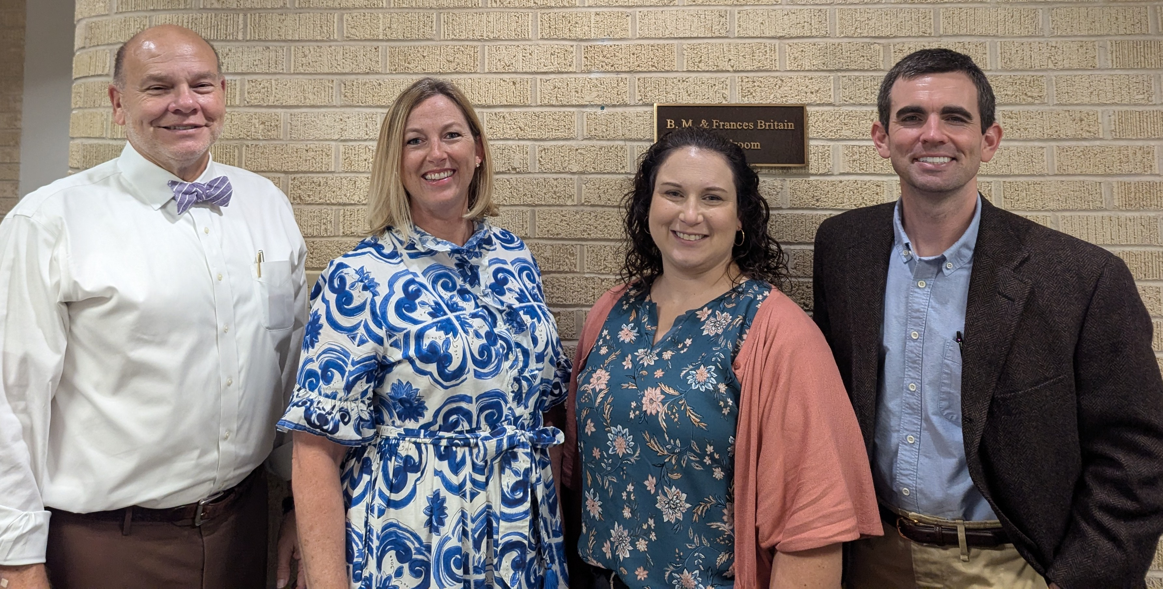
Questions?

